Slide 1


GOLD STOCK PREDICTION USING MACHINE LEARNING ALGORITHMS
NAME- ANIKET MITRA
COURSE - M. Sc Geoinformatics
UNIVERSITY - Symbiosis Institute Of Geoinformatics

Slide 2


CONTENTS
INTRODUCTION
OBJECTIVES
DATASET OVERVIEW
EDA
MACHINE LEARNING ALGORITHMS
TIME SERIES ANALYSIS - LINEAR REGRESSION
DECISION TREE AND SUPPORT VECTOR MACHINE (SVM)
GRADIENT BOOSTING AND RANDOM FOREST
DEEP LEARNING ALGORTIHMS - CNN, ANN, RNN
CONCLUSION
RECOMMENDATIONS
3
4
5
6
7
8
9
12
13
14
15

Slide 3
INTRODUCTION
The Nasdaq, or Nasdaq Stock Market, is a stock exchange in the United States. It is one of the world's largest stock exchanges by market capitalization. The Nasdaq Composite is trading at 17,496.82, which is down 1.09% from the opening price. The Nasdaq-100 is trading at 19,700.43, which is down 0.26% from the opening price. The NASDAQ itself doesn't directly track individual stocks of gold companies. Several gold mining companies are listed on the NASDAQ exchange such as Barrick Gold Corporation (GOLD), Newmont Corporation (NEM) , Agnico Eagle Mines Limited (AEM). I have used several machine learning algorithm techniques to detect the gold stock price prediction of Nasdaq from January 19,2014 to January 22, 2024. I have done a trend analysis for a decade and tries to detect the price of the stock exchange market and observe the results. The detection was done to analyze the spanning in gold prices from 2014-2024.
,

Slide 4
OBJECTIVES
1. Explore historical trends and patterns in gold prices over the specified time period.
2. Develop predictive models to forecast future gold prices based on historical data.
3. Formulate and back test trading strategies based on the provided price and volume information.
4. Assess market sentiment and its influence on short-term and long-term price movements.
5. Conduct statistical tests and analyses to gain insights into the characteristics of gold price movements.

Slide 5
DATA OVERVIEW
1. Date: A unique identifier for each trading day.
2. Close: Closing price of gold on the respective date.
3. Volume: Gold trading volume on the corresponding date.
4. Open: Opening price of gold on the respective date.
5. High: The highest recorded price of gold during the trading day.
6. Low: The lowest price recorded for gold in the trading day.

Slide 6
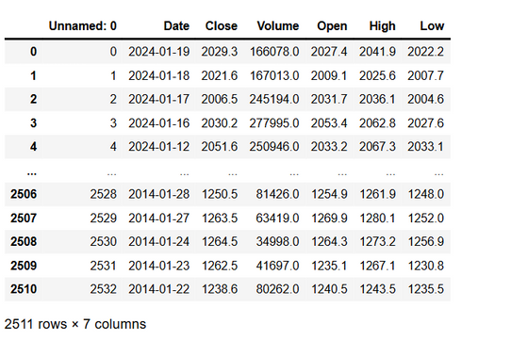
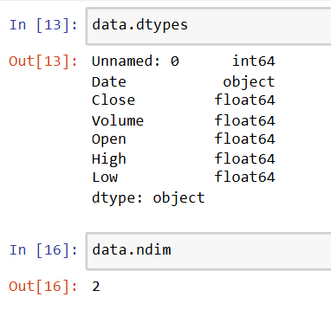
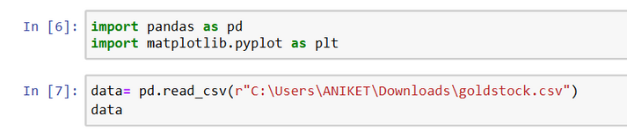


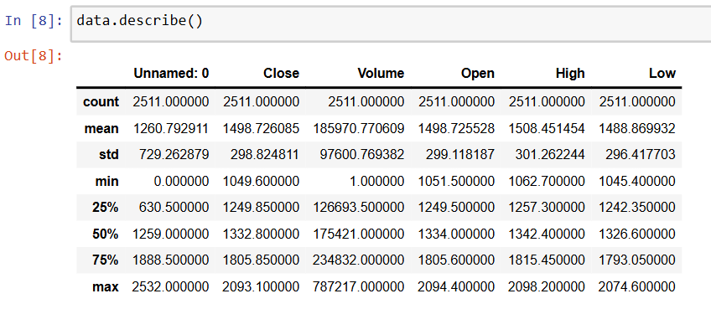
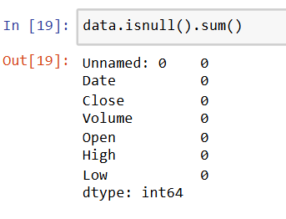
EXPLORATORY DATA ANALYSIS (EDA)
BASIC FUNCTIONS -

Slide 7
MACHINE LEARNING ALGORITHMS
Machine learning algorithms are essentially the instructions that allow computers to learn from data. They are a set of rules or processes that a computer uses to analyze data, identify patterns, and then make predictions or decisions based on those patterns. There are many different machine learning algorithms, each with its own strengths and weaknesses, and the choice of algorithm depends on the specific task you want the computer to perform.
Key Concepts related to Machine Learning are -
Learning from Data: Machine learning algorithms don't need to be explicitly programmed for every situation. Instead, they are trained on large amounts of data. This data allows the algorithm to identify patterns and relationships within the data.
Identifying Patterns: Once trained, the algorithm can then use those patterns to make predictions about new data. For instance, an algorithm trained on pictures of cats and dogs can be used to identify whether a new picture is a cat or a dog.
Making Predictions or Decisions: These predictions can be used for a variety of purposes, such as recommending products to customers, filtering spam emails, or even controlling self-driving cars.

Slide 8
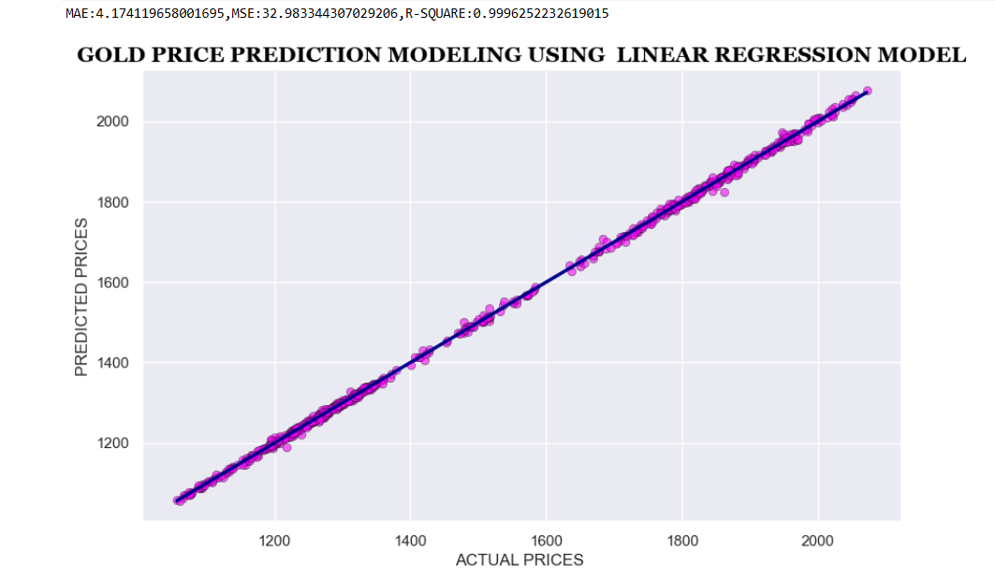
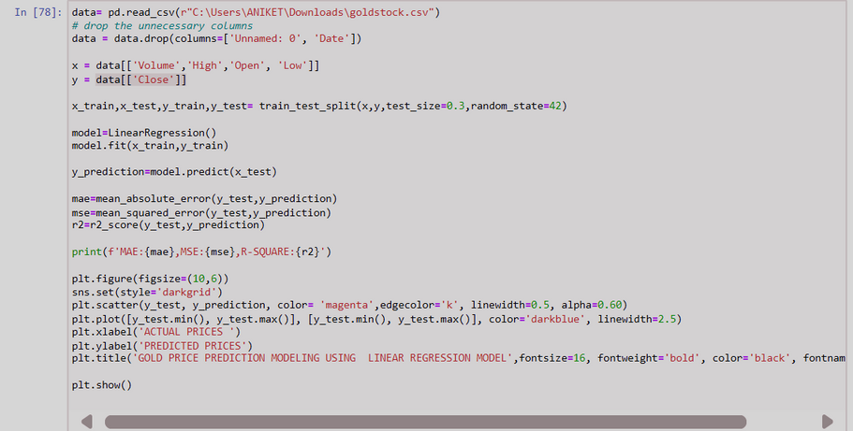
LINEAR REGRESSION MODEL
LINEAR REGRESSION MODEL-
Linear regression is a fundamental building block in machine learning, particularly useful for continuous predictions. It's a supervised learning method that unveils the relationship between a dependent variable (what you're trying to predict) and one or more independent variables (what influences the prediction). Imagine you want to predict house prices. The price (dependent variable) is influenced by factors like size (independent variable). Linear regression finds the equation for a best-fitting straight line that minimizes the difference between the actual prices and the predicted prices based on the size. This allows you to estimate prices for new houses based on their size.

Slide 9
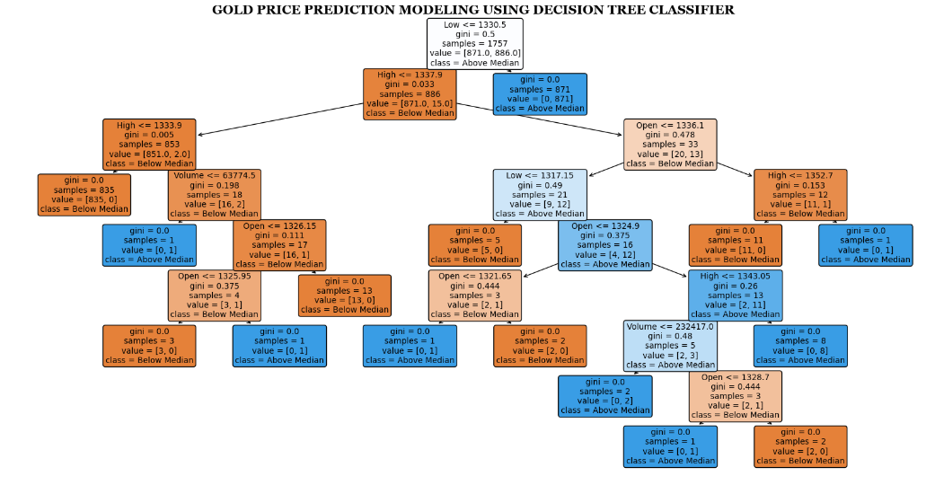
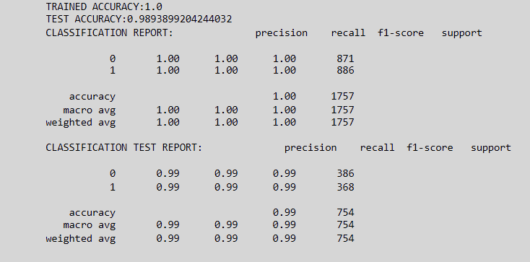
DECISION TREE CLASSIFIER
DECISION TREE CLASSIFIER -
Build a tree structure: The algorithm aims to create a tree-like model with decision rules at each branch.
Split data efficiently: At each branch, it seeks the best split that separates the data points into the most homogeneous groups regarding the target variable (what you're predicting).
Maximize purity: The goal is to reach "leaf nodes" containing only data points belonging to the same class (e.g., all emails classified as spam).
Improve classification accuracy: By creating these pure leaf nodes, the decision tree aims to make the most accurate predictions possible for new data.

Slide 10
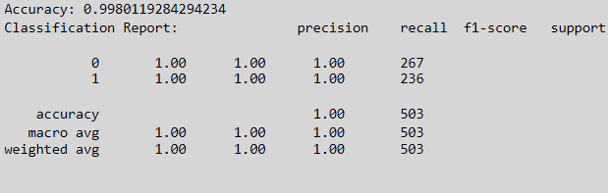
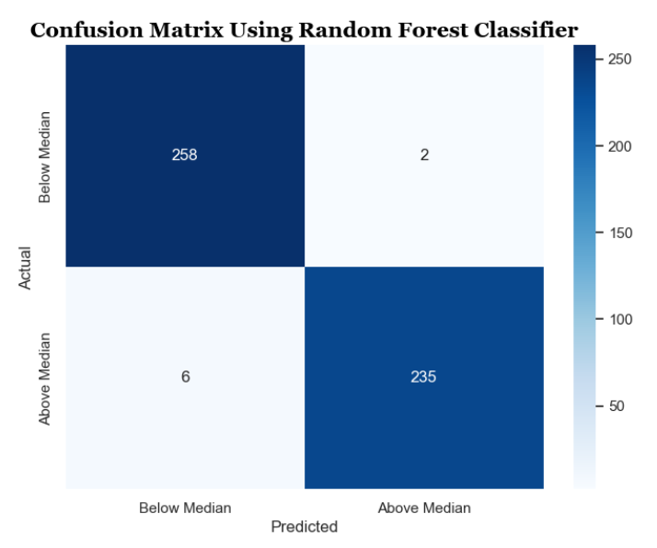
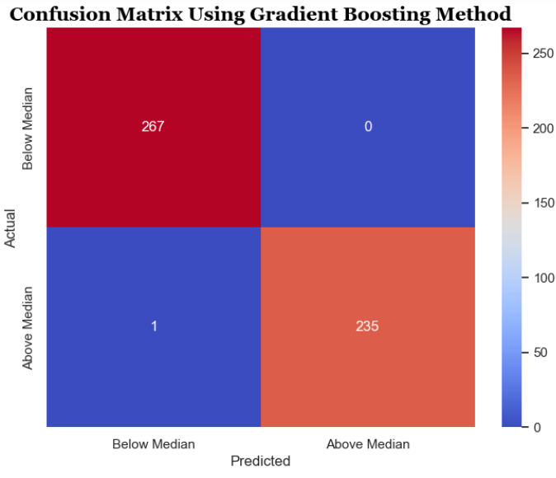
RANDOM FOREST Vs GRADIENT BOOSTING
Random Forest:
Ensemble Method: Random Forest is an ensemble method, meaning it combines the predictions of multiple decision trees.
Building Trees: This injects randomness and reduces overfitting.
Strengths: Easy to use, robust to noise in data, interpretable due to individual trees.
Weaknesses: Can be less accurate than Gradient Boosting for complex problems.
Gradient Boosting:
Sequential Learner: Gradient Boosting takes a sequential approach. It trains decision trees one by one, focusing on correcting the errors.
Prediction: Similar to Random Forest, the final prediction is made by combining the predictions from all the trees.
Strengths: Can achieve higher accuracy, especially for complex data.
Weaknesses: Can be slower to train, more prone to overfitting if not carefully tuned, and less interpretable due to the complex interaction

Slide 11
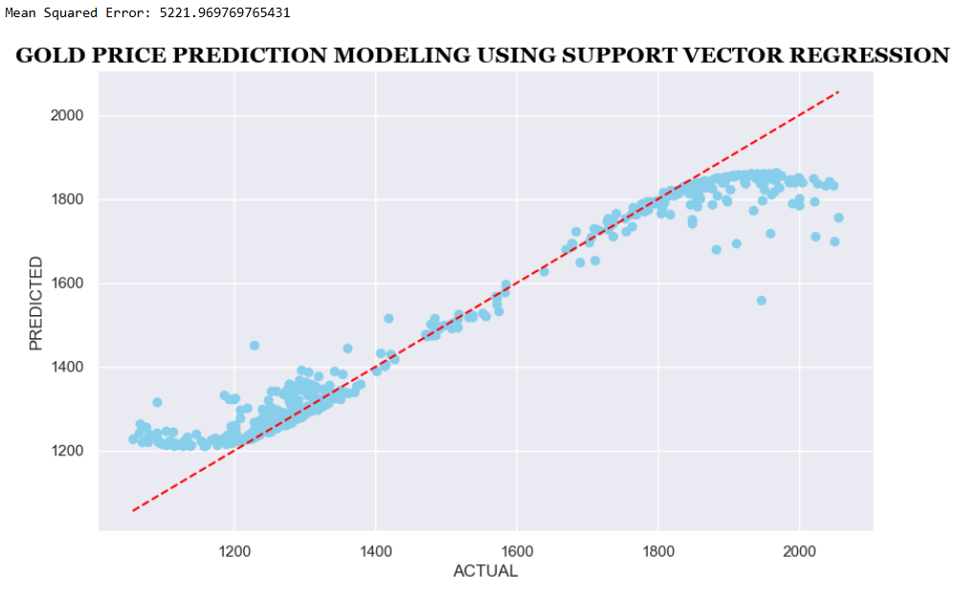
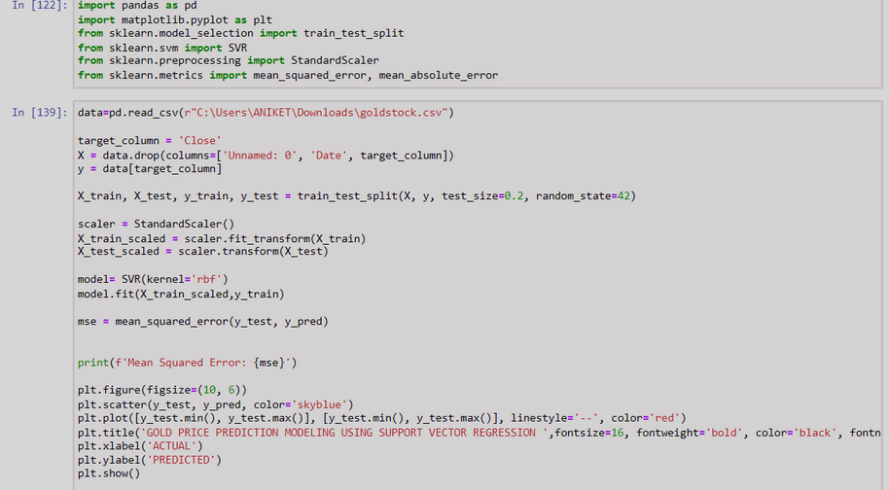
SUPPORT VECTOR MACHINE (SVM)
SUPPORT VECTOR MACHINE -
SVM aims to identify the optimal hyperplane (decision boundary) in high-dimensional space that separates the data points belonging to different classes.
The algorithm primarily focuses on these support vectors as they define the decision boundary.
SVMs can be used for classification (predicting categories) and regression

Slide 12
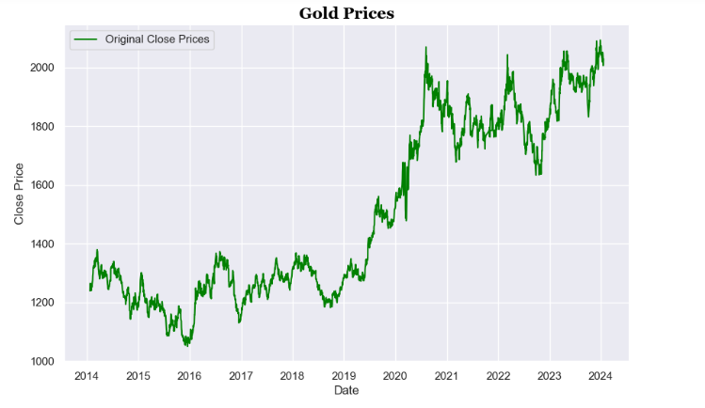
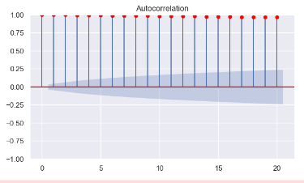
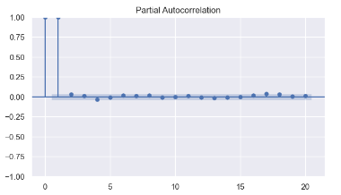
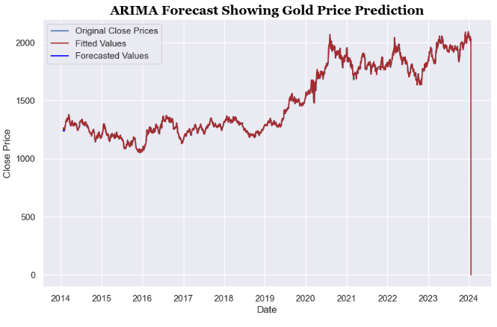
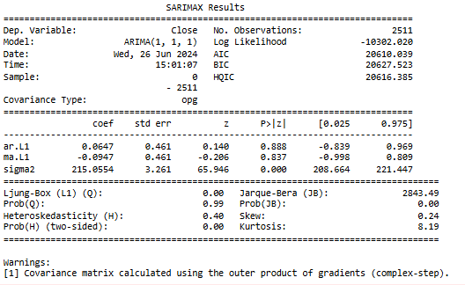
ARIMA
ARIMA, which stands for AutoRegressive Integrated Moving Average, is a statistical model widely used for time series forecasting. It's a powerful tool for analyzing and predicting future trends in data that exhibits a sequential order, like stock prices, sales figures, or weather patterns.

Slide 13
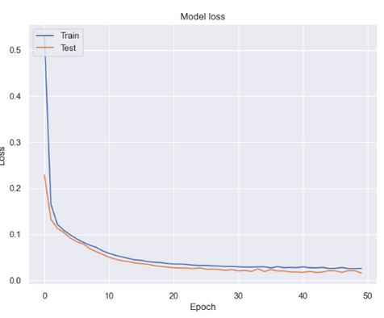
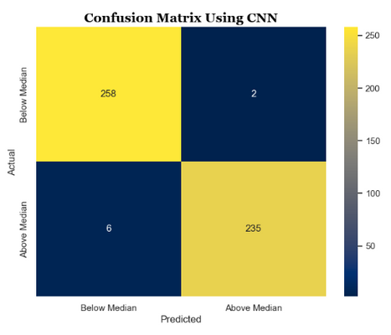
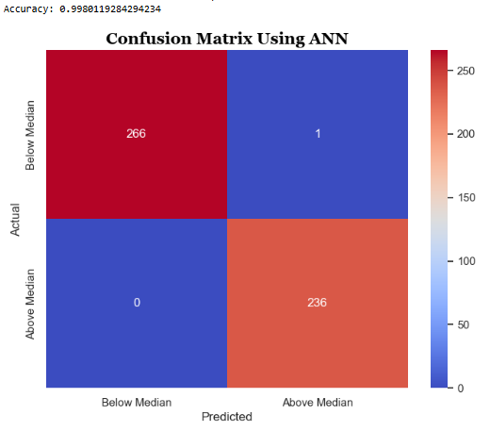
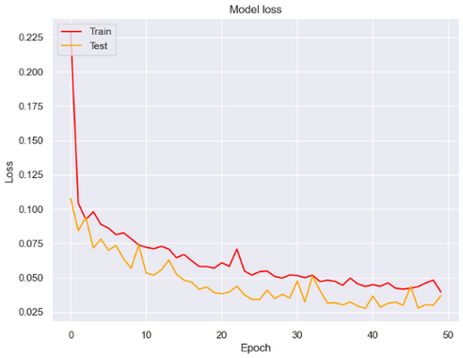
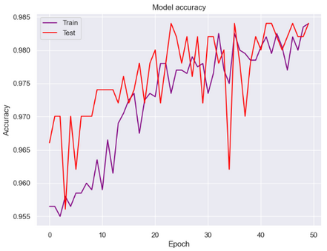
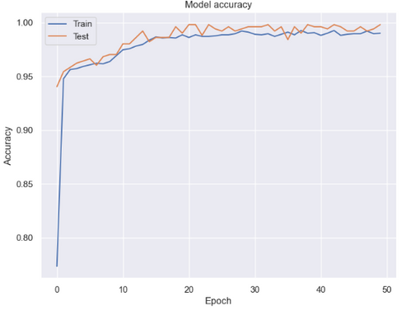
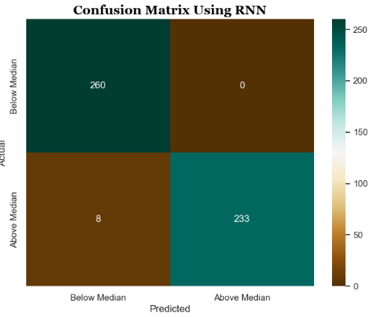
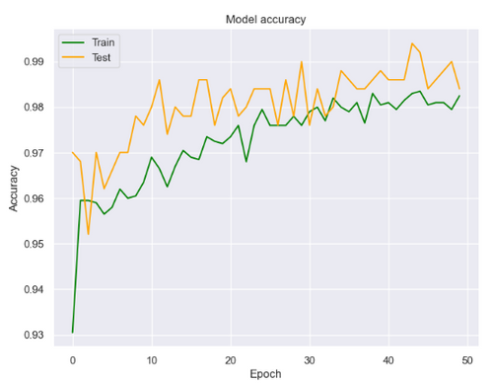
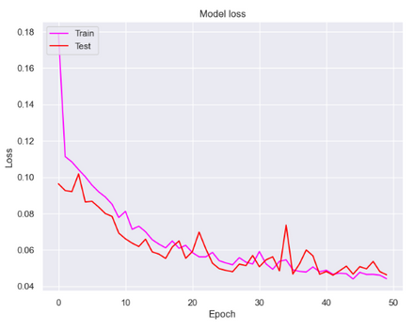
NEURAL NETWORKS MODELS
ANN-
ANN stands for Artificial Neural Network. It's a computational model inspired by the structure and function of the biological neural networks in animal brains
CNN-
CNN stands for Convolutional Neural Network. It's a specific type of deep learning architecture particularly well-suited for image and video recognition tasks.
RNN-
RNN stands for Recurrent Neural Network. RNNs are specifically designed to handle sequential data, where the order of information matters.

Slide 14

CONCLUSION AND RECOMMENDATIONS
The best machine learning technique depends on your prediction task. For numerical predictions, linear regression is a good starting point. For images, Convolutional Neural Networks (CNNs) excel at recognizing patterns. For sequential data like text or time series, Recurrent Neural Networks (RNNs) can handle the order of information. These are just a few examples, and the best approach depends on your specific data and what you're trying to predict. Decision Trees are easy to interpret and robust to noise, making them good for initial predictions or understanding which factors influence the outcome.

